Slide 1

Heroes Of Realm
Java Project on Game
Presented By: Sumit
Roll No: 22SW027

Slide 2
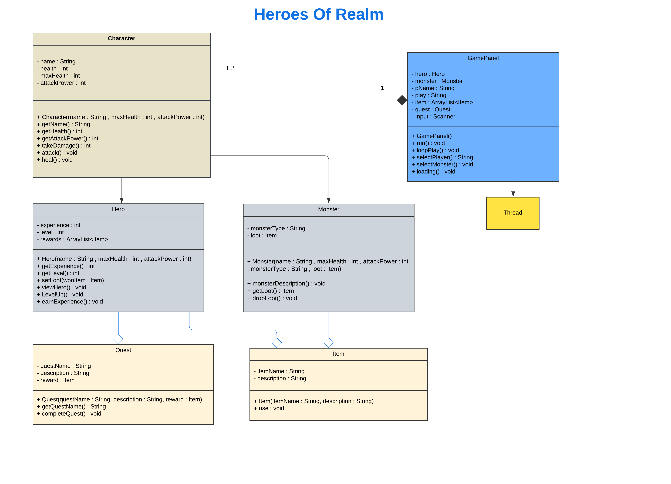

Slide 3
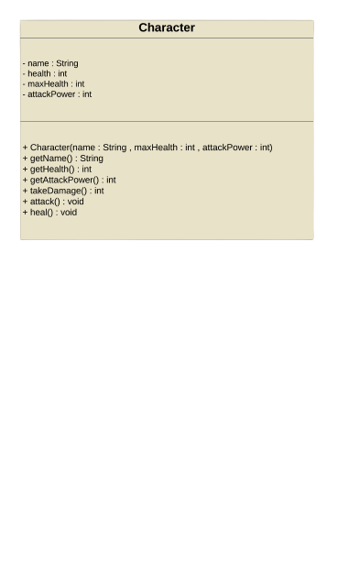
Character Class

Slide 4
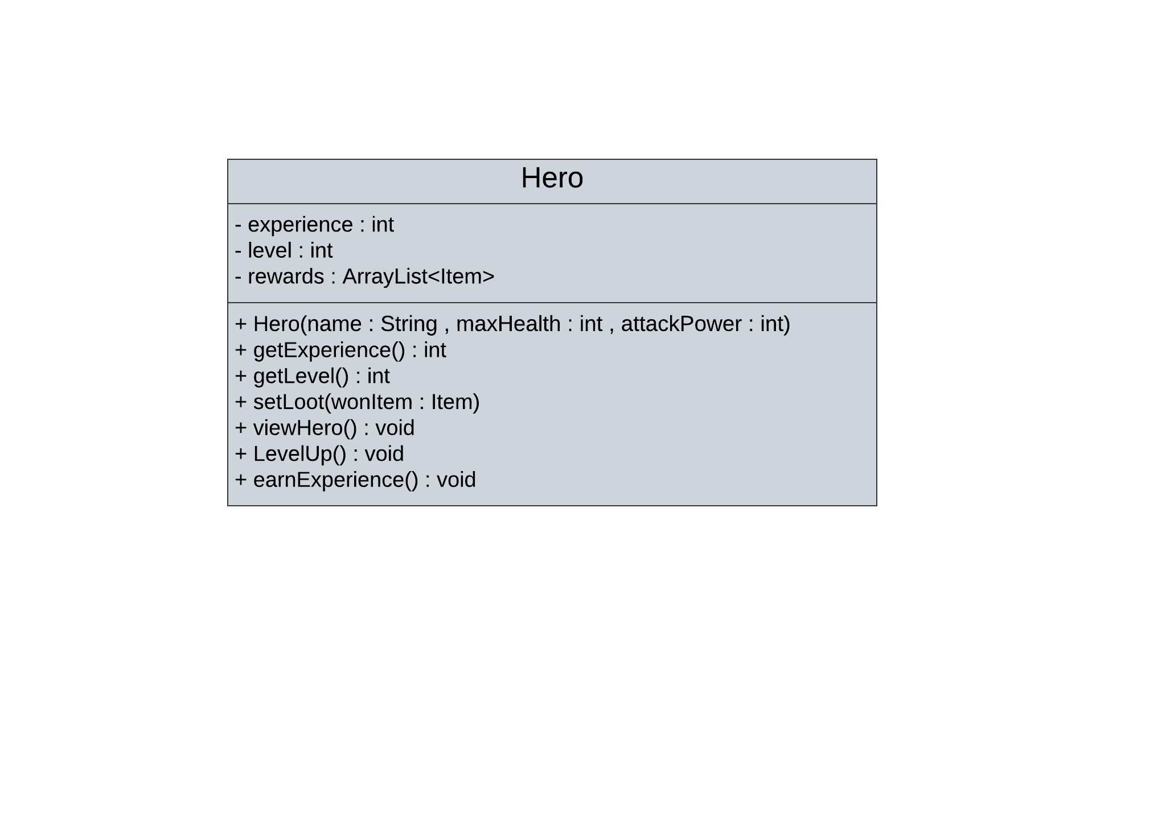
Hero Class

Slide 5
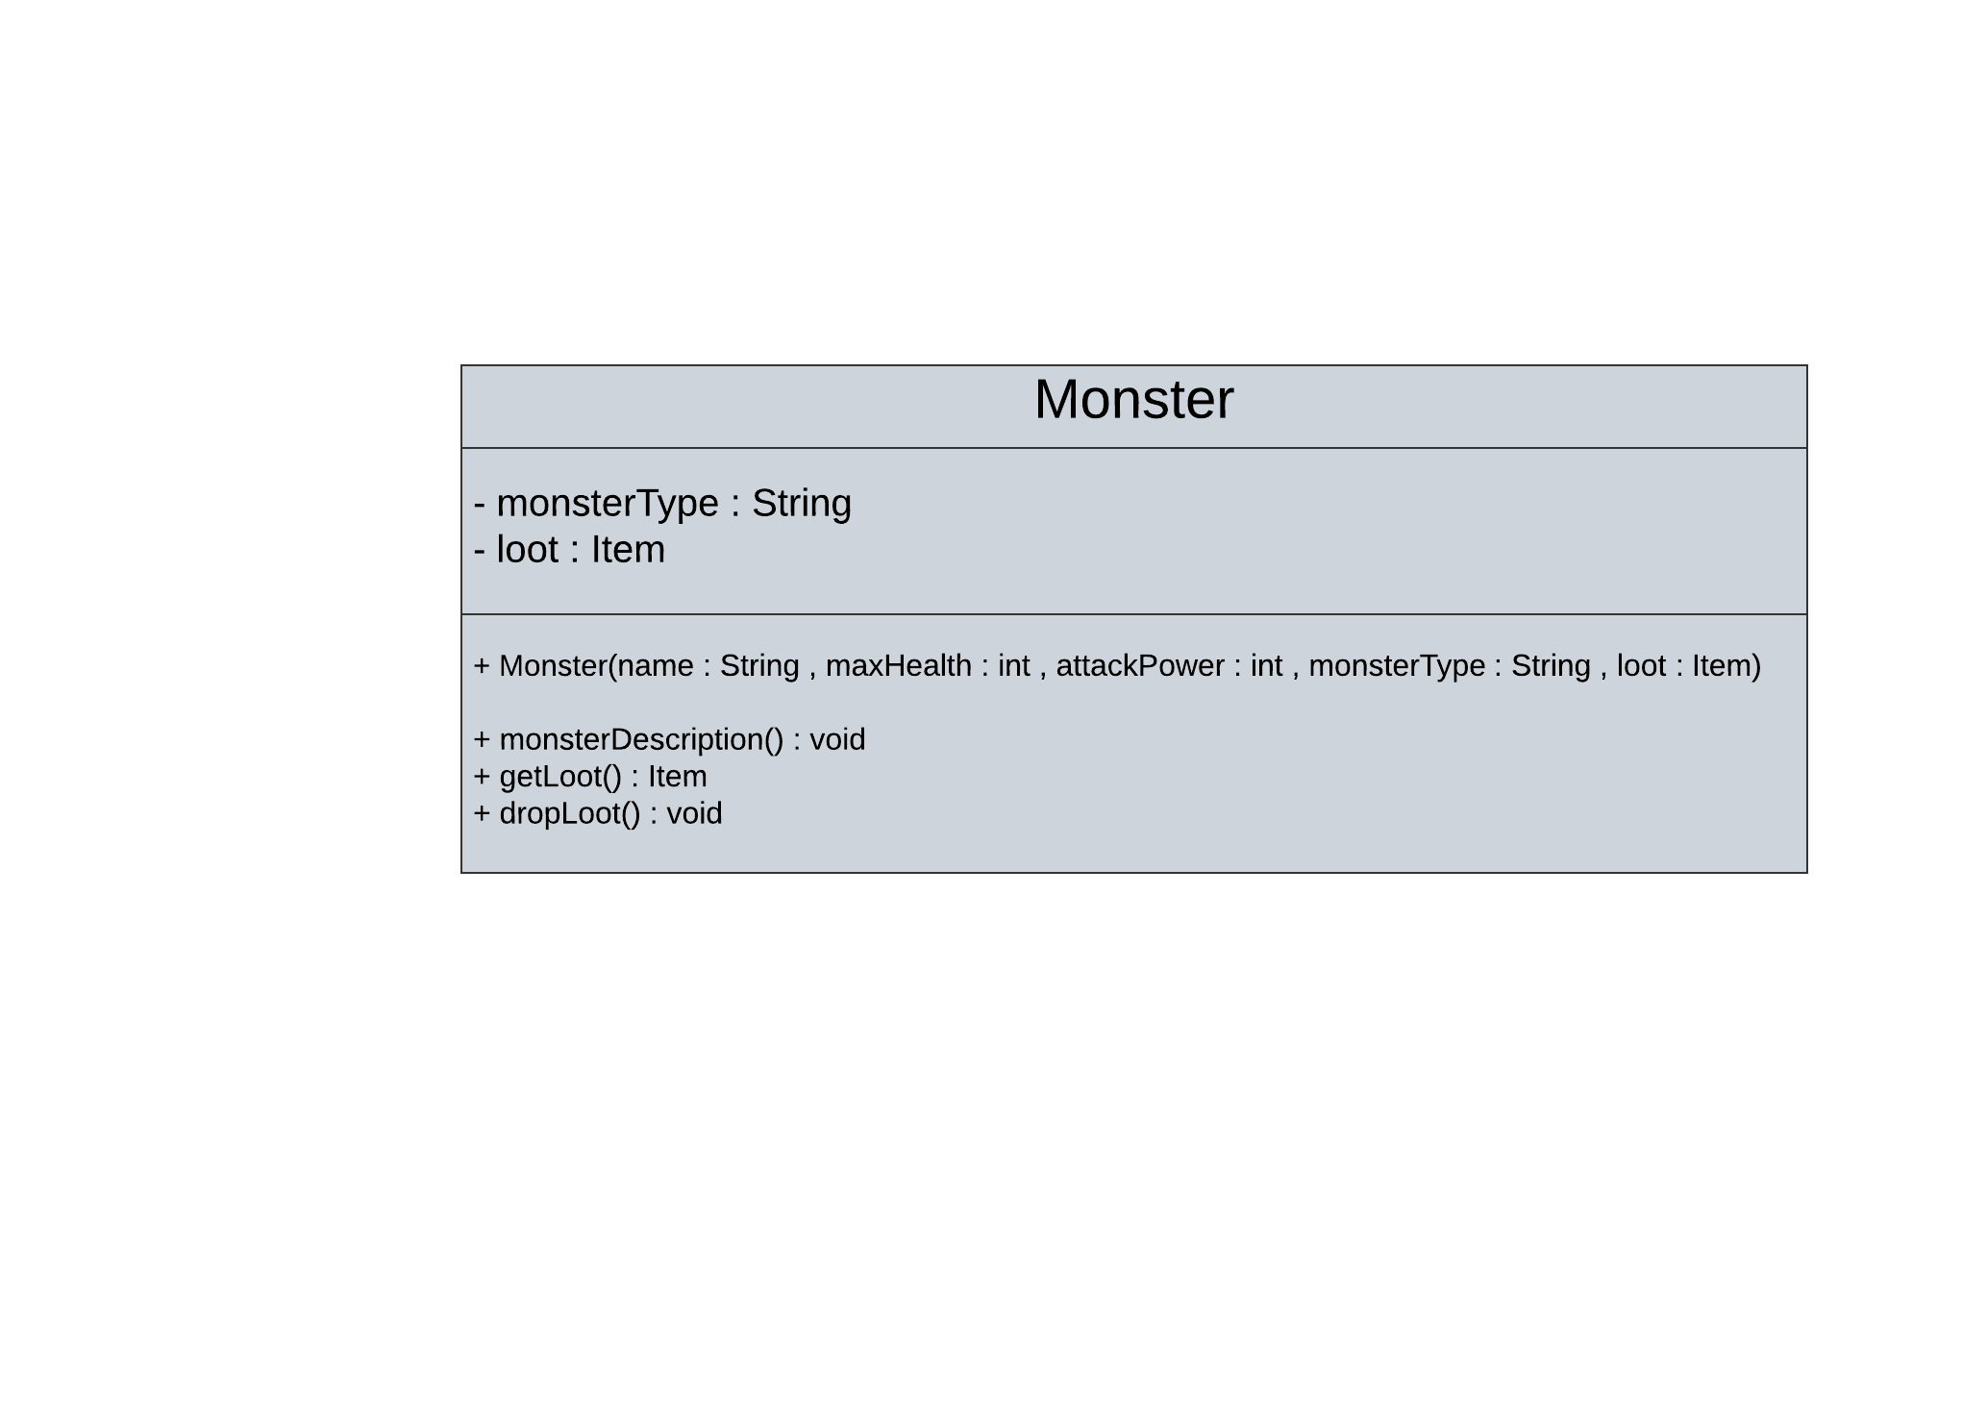
Monster Class

Slide 6
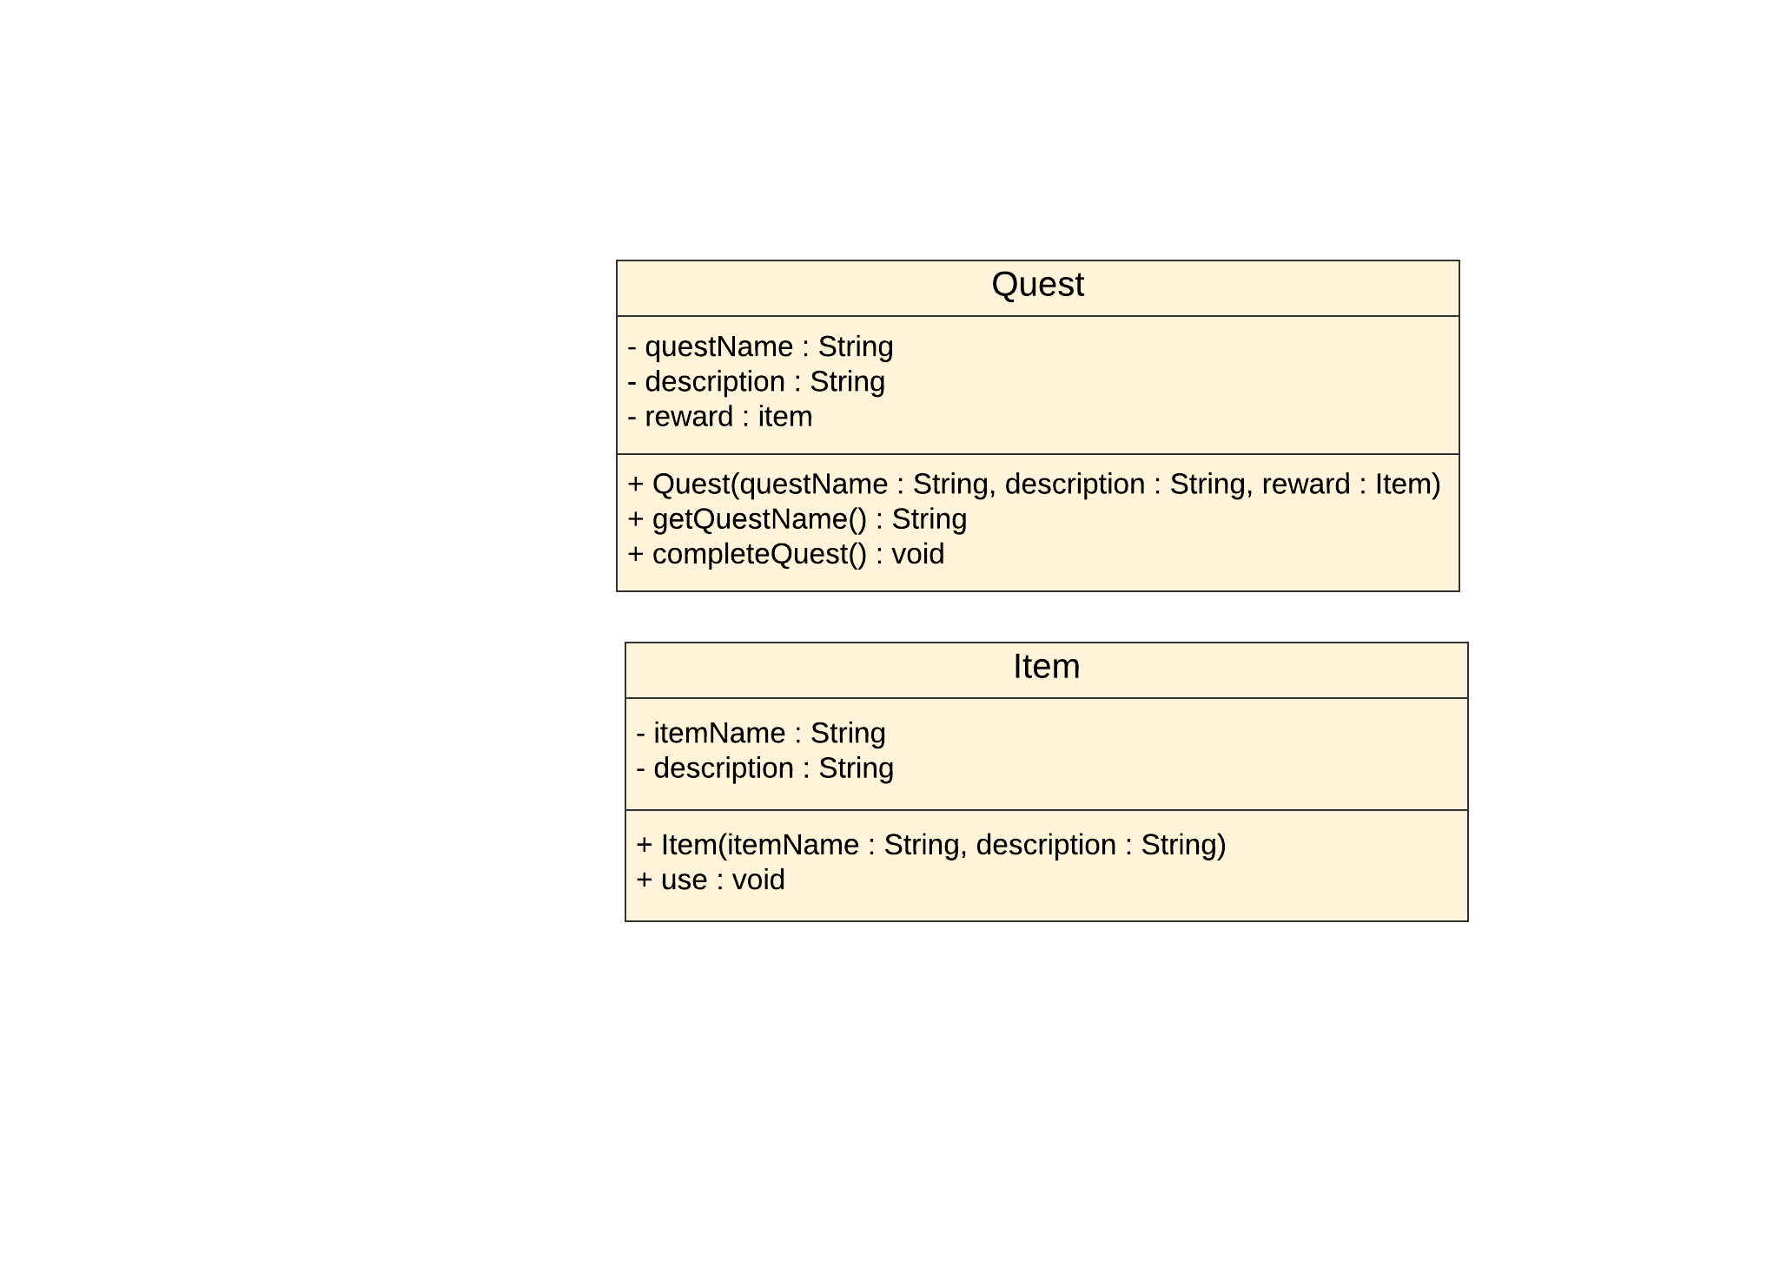
Item and Quest Classes

Slide 7
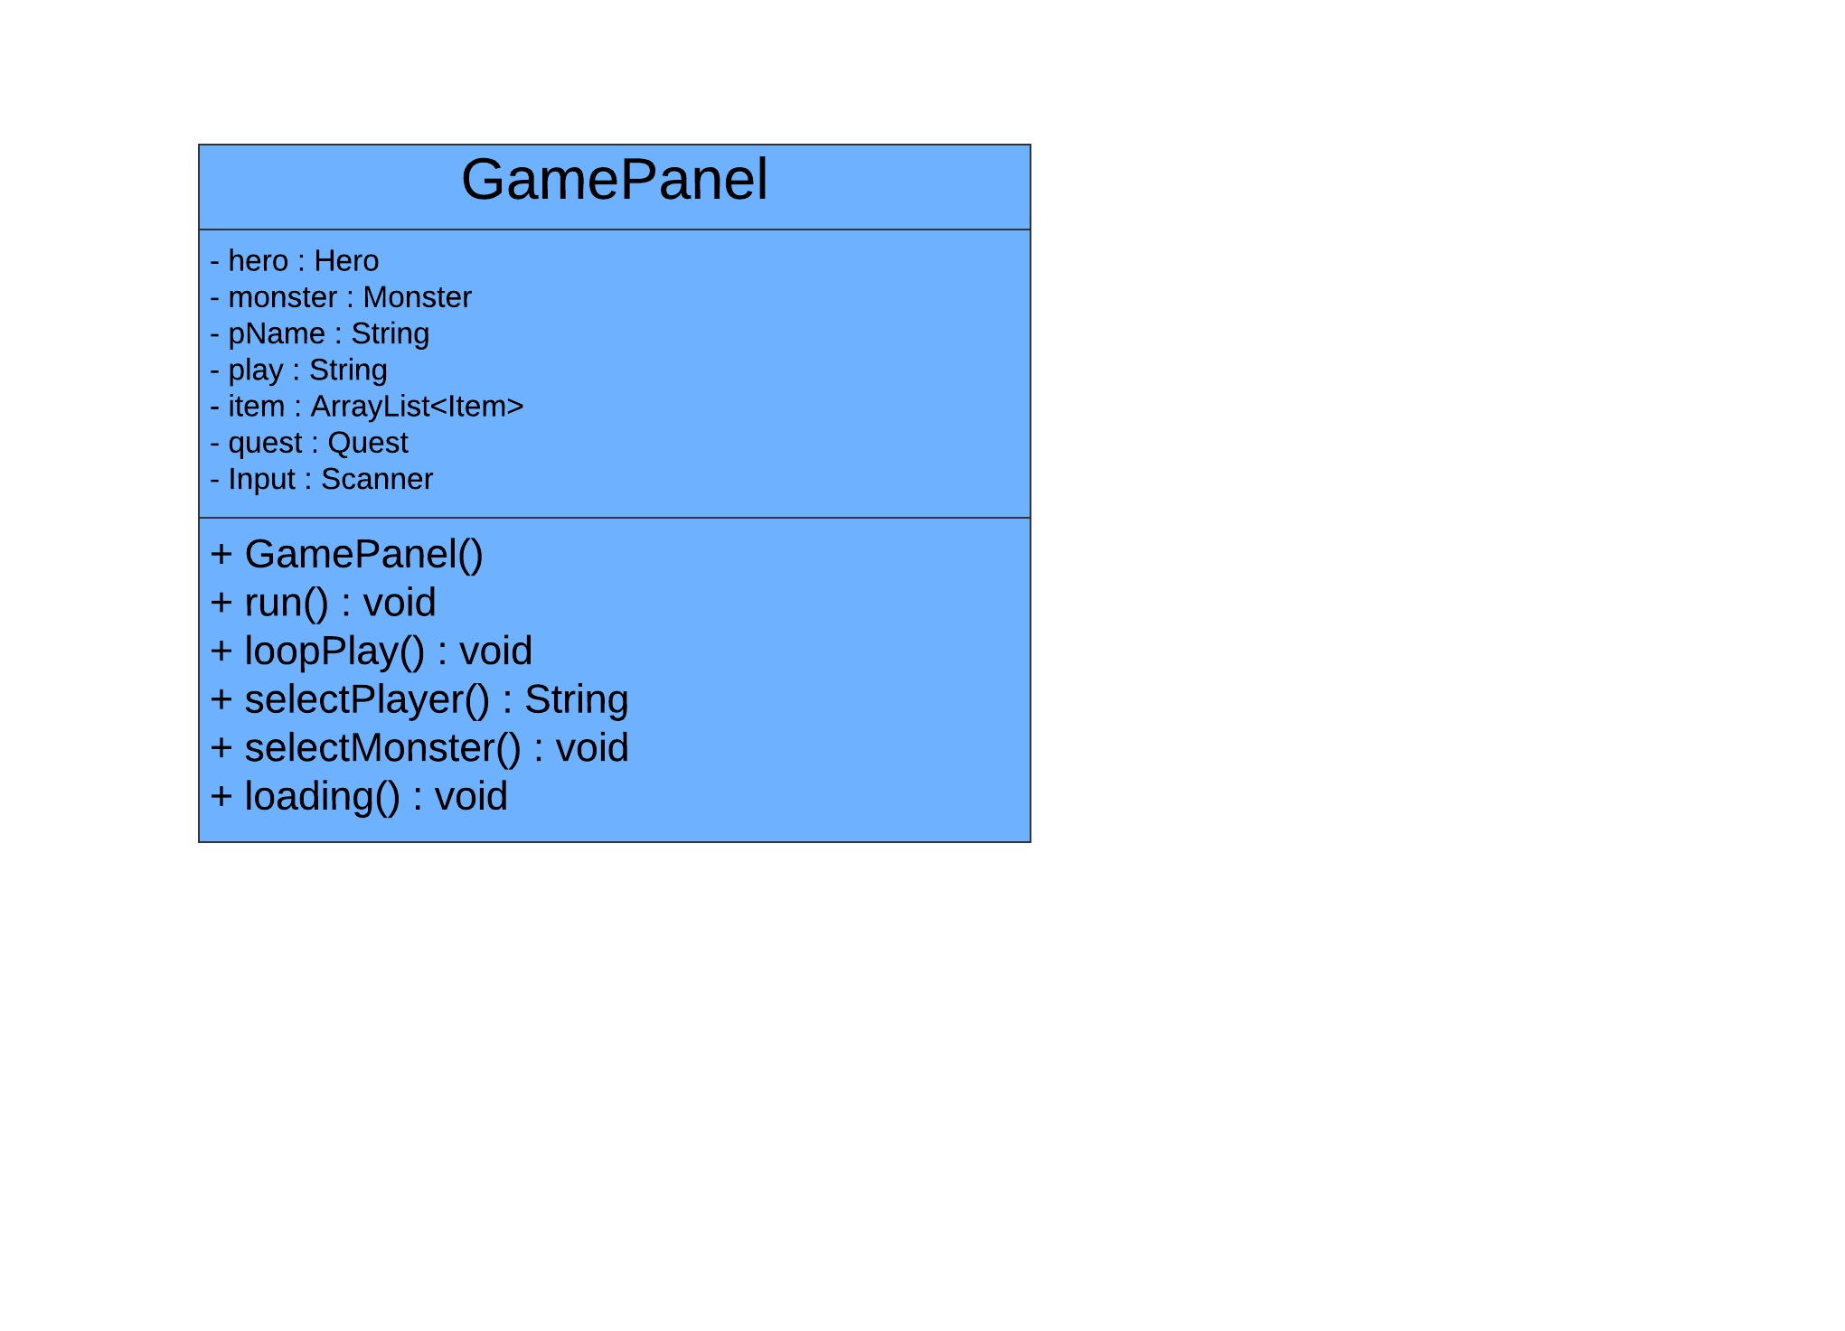
Game Panel Class

